Slide 1
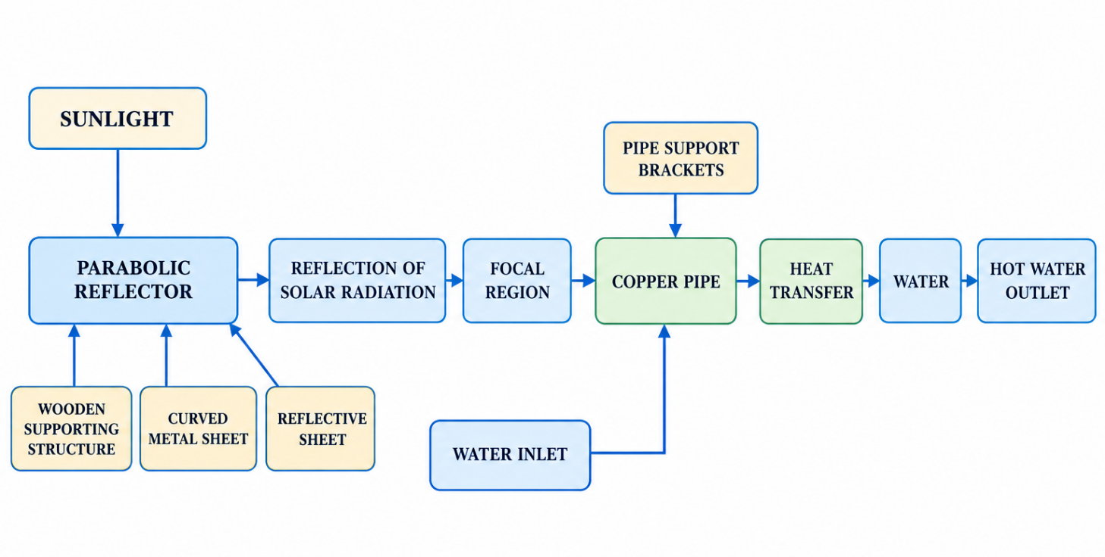
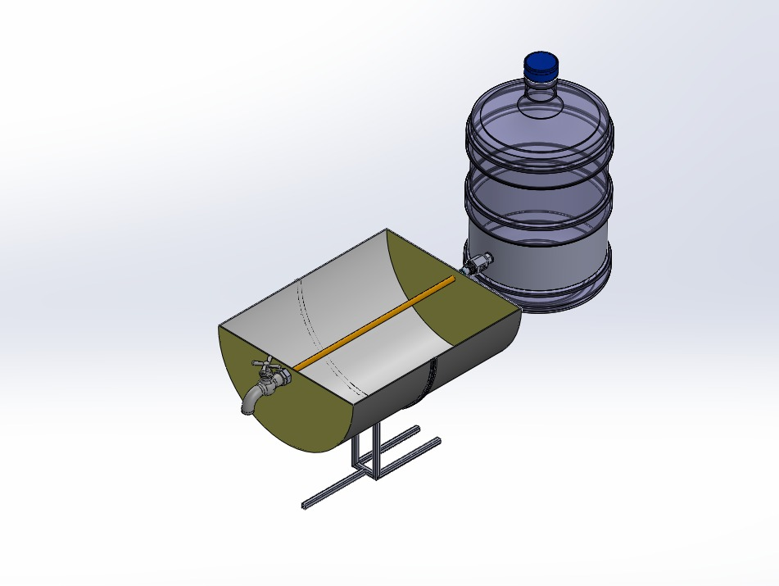
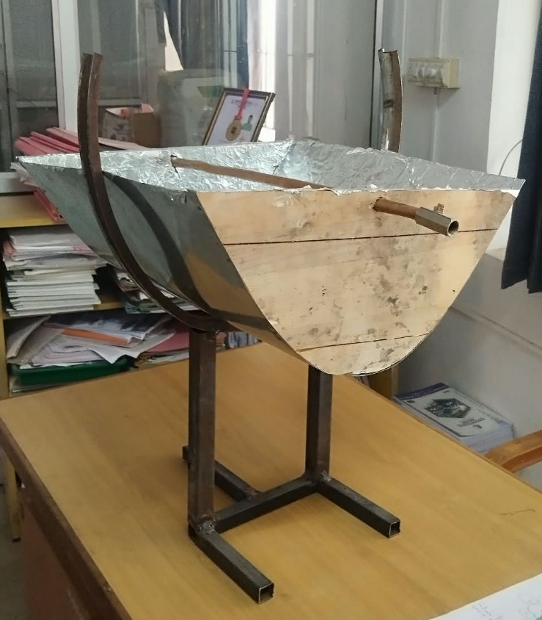
DESIGN AND FABRICATION OF A PARABOLIC
SOLAR WATER HEATER USING COPPER PIPE
Project Abstract
Rising demand for hot water in homes and small businesses has increased dependence on electrical and fuel-based water heaters, raising cost and
emissions. This project designs and fabricates a mechanically operated parabolic solar water heater that concentrates sunlight to heat water
using a copper pipe. A wooden-frame parabolic trough (focal length 73 mm) reflects incident solar radiation onto the pipe, raising its
temperature and transferring heat to the water flowing inside. Across outdoor trials, water temperature rose by up to 22 deg C
in a single 60-minute trial, confirming solar concentration as a simple, low-cost, renewable alternative for domestic water heating.
Problem Statement
Conventional water heating depends mainly on electricity or fuel, increasing running cost and consuming non-renewable resources, and many existing
solar water heaters use complex collectors, insulation, pumps and controllers that raise cost and maintenance requirements.
There is a need for a simple mechanical solar heater that demonstrates concentrated solar heating using easily available materials.
Need for the Project
The project demonstrates a renewable, low-cost water heating alternative that cuts electrical and fuel consumption while teaching solar
concentration, heat transfer and mechanical design principles, trading tracking precision for simplicity and affordability in fabrication.
Project Objectives
Design a parabolic reflector to concentrate solar radiation onto a fixed focal line.
Position a copper pipe at the calculated focal point (f = 73 mm) to absorb concentrated heat.
Fabricate a low-cost mechanical prototype using wood, sheet metal and reflective sheet no electronics.
Experimentally evaluate water temperature rise and thermal efficiency under real solar exposure.
Components and Materials
Reflector & Frame: Wooden supporting structure, curved metal sheet, aluminium reflective sheet, base/support arrangement, fasteners, adhesive/fixing material.
Receiver & Fittings: Copper pipe (receiver), pipe support brackets, water inlet connection, water outlet connection.
Methodology / Workflow
Literature Review → Problem Definition & Objectives → Parabolic Geometry & Focal Length Calculation → Reflector Design → Material Selection
→ Wooden Frame & Reflector Fabrication → Copper Pipe Installation → Outdoor Testing → Results & Analysis → Conclusion & Future Scope
Working Principle
Sunlight falling on the aluminium-foil reflective surface is reflected toward the parabolic trough’s focal line, following the profile x2 = 4fy
with focal length f = 73 mm. The copper pipe positioned at this focal line absorbs the concentrated radiation and its temperature rises.
Heat conducts through the copper pipe wall and transfers by convection to the water flowing inside — a fully mechanical process with
no sensors, electronic controllers or electrical heating elements involved at any stage.
System Architecture
CAD Model / Prototype
Experimental Setup
The fabricated reflector was positioned outdoors with its aperture oriented toward the sun so that solar radiation fell on the reflective
surface. Water was supplied to the copper pipe through the inlet, and heated water was collected at the outlet after passing through the pipe.
Inlet and outlet temperatures were recorded at regular intervals across multiple trials and exposure durations.
Recorded Data (sample)
Results
Performance Evaluation
Challenges Encountered
Challenge: A curved metal sheet alone does not guarantee focal accuracy; small fabrication errors shift the focal line.
Solution: Used a wooden template cut to the exact parabolic profile (x2 = 4fy) to guide metal-sheet forming and verify the 73 mm focal position before fixing the copper pipe.
Challenge: Measuring water temperature reliably under changing outdoor solar conditions.
Solution: Recorded inlet/outlet readings at fixed time intervals across repeated trials at similar times of day for consistency.
Innovation / Novel Features
A fully mechanical parabolic concentrator that heats water using only reflected sunlight — no sensors, controllers, pumps or electrical
heating elements — built entirely from low-cost wood, sheet metal, aluminium foil and copper pipe.
Applications
Domestic water preheating
Rural and small-scale hot-water applications
Educational and solar-thermal demonstration laboratories
Small-scale agricultural and outdoor washing applications
Future Scope
  Selective absorber coating on the copper pipe to reduce radiative losses
  Larger aperture area and improved reflective material for higher heat gain
  Manual or mechanical sun-tracking to maintain focal alignment through the day
  Insulated storage tank and integration with domestic plumbing
Time | Inlet Temp (°C) | Outlet Temp (°C)
10:00 AM | 28 | 32
10:15 AM | 28 | 34
10:30 AM | 29 | 36
10:45 AM | 29 | 38
11:00 AM | 30 | 41
Module | Result
Prototype Fabrication | Parabolic wooden-frame reflector with aluminium-foil surface successfully built
Temperature Monitoring | Inlet and outlet water temperature recorded manually across multiple trials
Heating Performance | Water temperature rose by up to 22°C over a 60-minute solar exposure
Reflector Alignment | Stable focal positioning confirmed by consistent ΔT across repeated trials
Metric | Outcomes
Water Temperature Rise | Up to 22°C (60 min exposure)
Heating Method | Fully mechanical solar concentration, no electrical input
Prototype Cost | Rs. 3,000 (materials)
Total Project Cost | Rs. 4,800 (materials + fabrication)
System Stability | Consistent ΔT trend across repeated trials at similar times of day
Skills Acquired
  Technical Skill: 3D CAD modeling, parabolic reflector geometry design, heat-transfer and thermal-efficiency calculations, workshop fabrication (wood & sheet metal)
  Soft Skill: Teamwork, field research, technical documentation, project management.
Project Outcomes
A working parabolic solar water heater was fabricated and experimentally validated, achieving a water temperature rise of up to 22°C using only concentrated sunlight, confirming the feasibility of a simple mechanical solar concentrator for low-cost, renewable domestic water heating.
References
Kalogirou, S.A. (2004). Solar thermal collectors and applications. Progress in Energy and Combustion Science, 30(3), 231-295.
Duffie, J.A., Beckman, W.A., & Blair, N. (2020). Solar Water Heating, in Solar Engineering of Thermal Processes. Wiley.
Abdulhamed, A.J. et al. (2018). Review of solar parabolic-trough collector geometrical and thermal analyses. Renewable and Sustainable Energy Reviews, 91, 822-831.
Salgado Conrado, L. et al. (2017). Thermal performance of parabolic trough solar collectors. Renewable and Sustainable Energy Reviews, 67, 1345-1359.
Acknowledgements
  We thank our project guide and faculty mentors (Mr. A. Kamalakannan, B.E., M.E, (Ph.D) )
  Thanks to the lab staff for providing access to components and tools.
[Insert QR Code]
QR Code — Project Report (PDF) | Design Calculations | Demonstration Video
Contact information
Department of Mechanical Engineering
Knowledge Institute of Technology, Salem
Email: 2k23me013@kiot.ac.in | 2k23me006@kiot.ac.in | 2k23me003@kiot.ac.in | 2k23me020@kiot.ac.in
College website : www.kiot.ac.in

